Slide 1
MPM with Cuda
By: Daniel Palomino

Slide 2
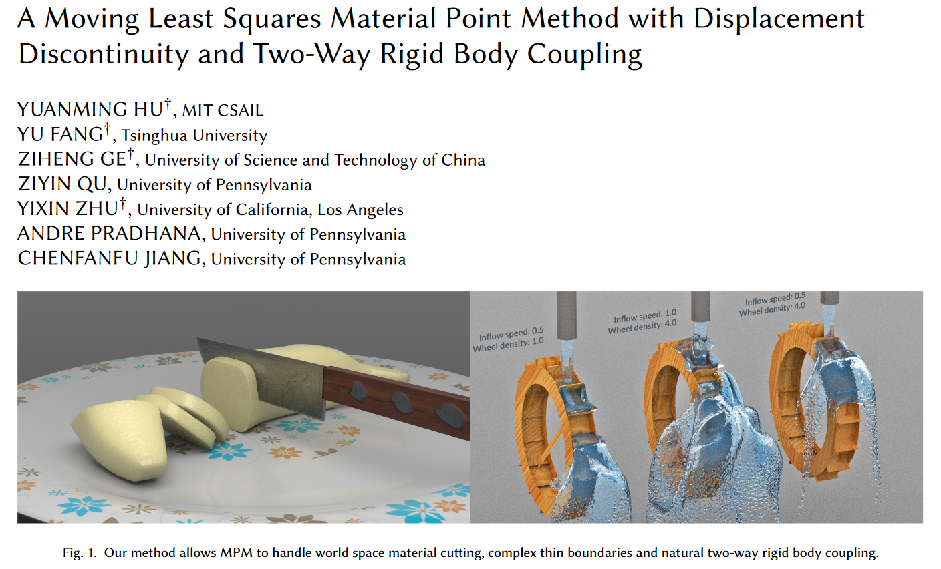
Paper to work

Slide 3
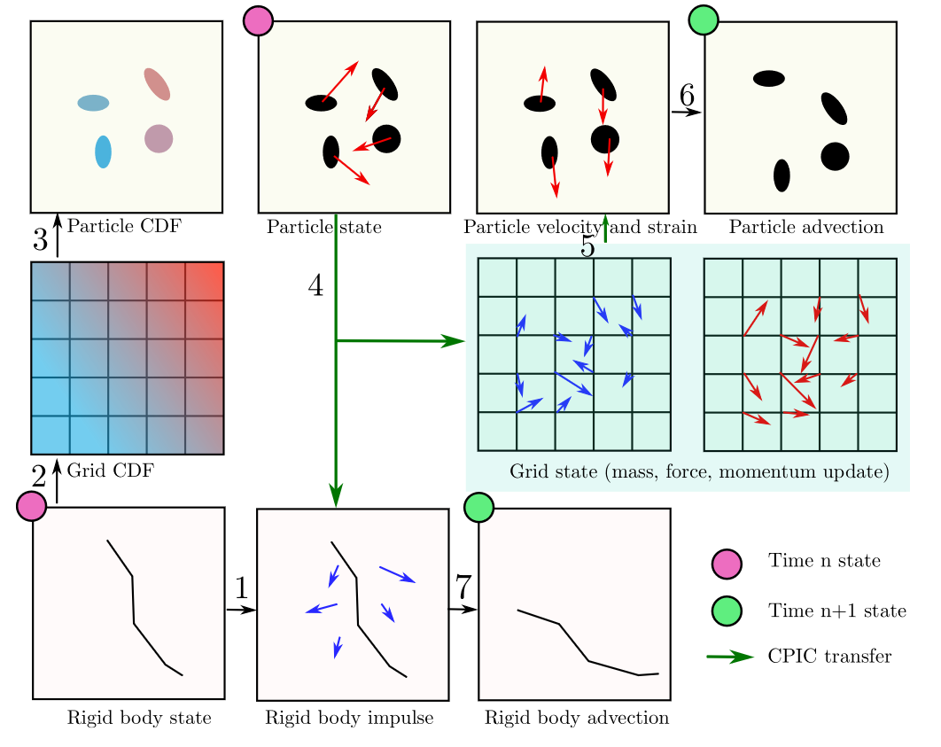
MLS-MPM (Graphic)

Slide 4
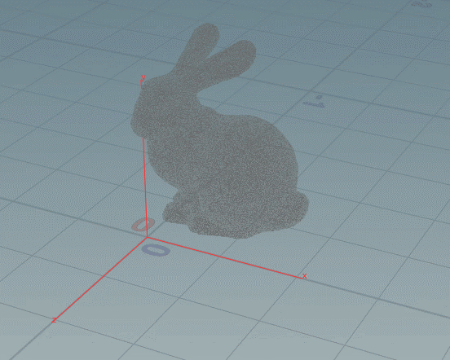

Objective:

Slide 5
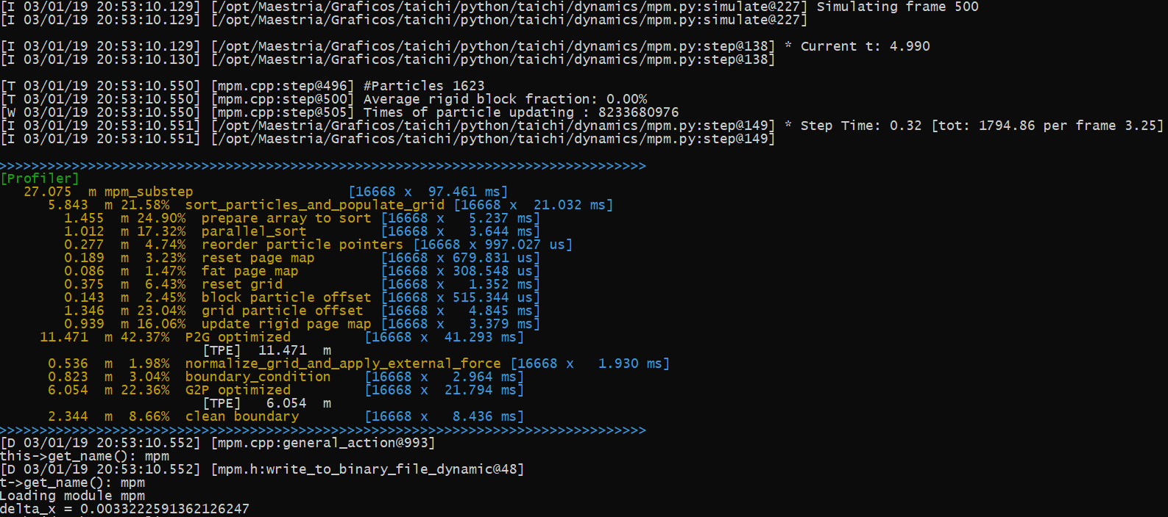
Distribution Time

Slide 6
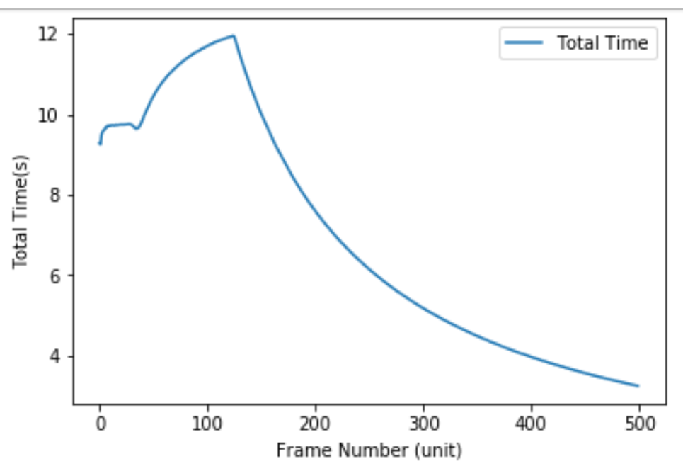
Taichi: Simulation Time

Slide 7
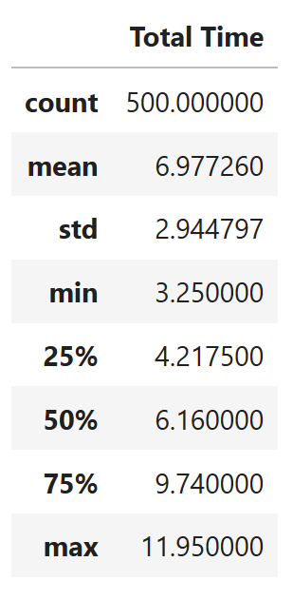
Taichi: Simulation Time

Slide 8
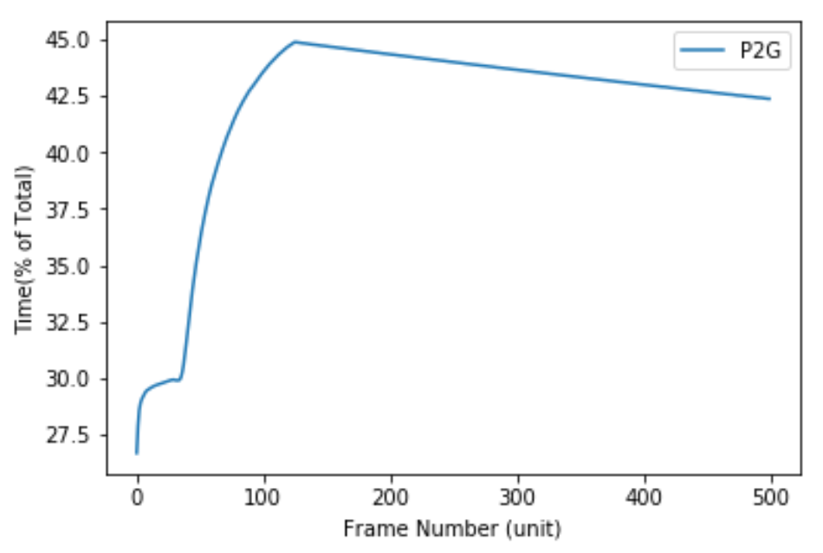
Taichi: Particle To Grig Time

Slide 9
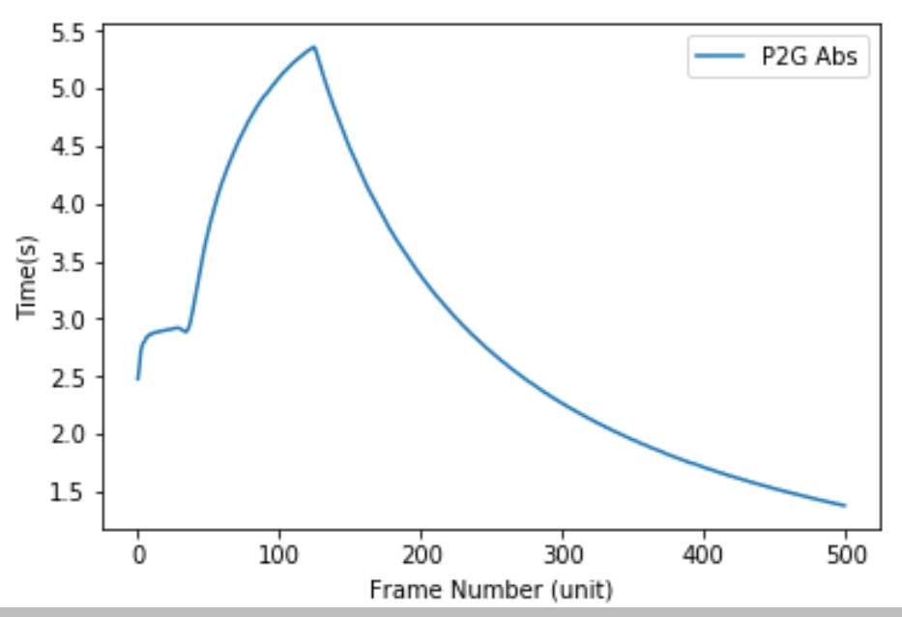
Taichi: Particle To Grig Time

Slide 10
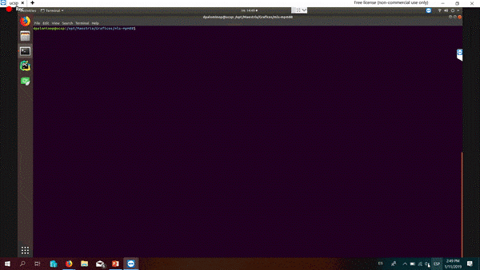

First Approach

Slide 11
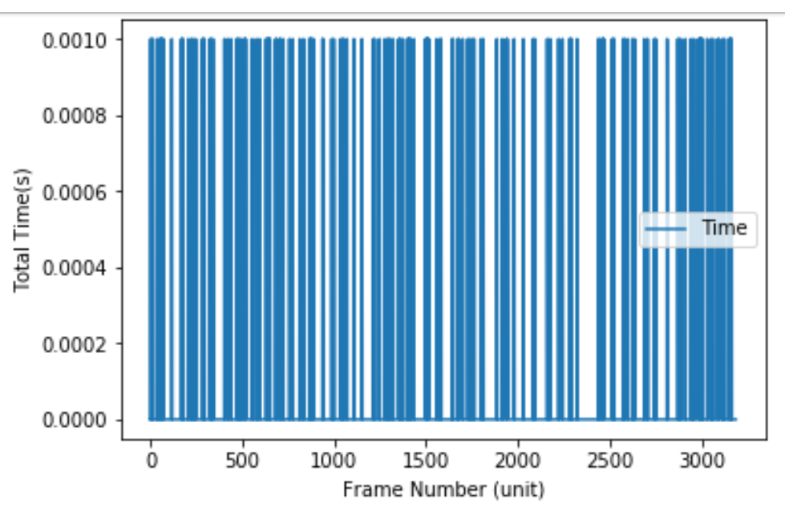
Cuda Implementation

Slide 12
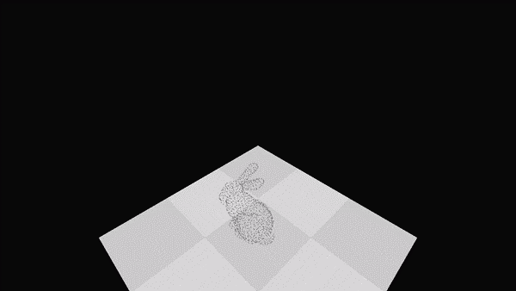
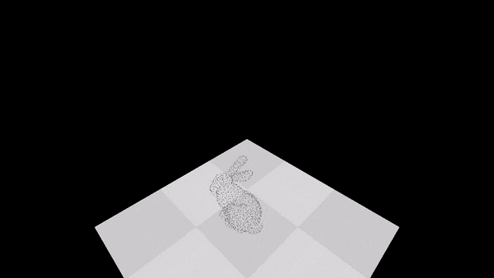
Demo 01

Slide 13
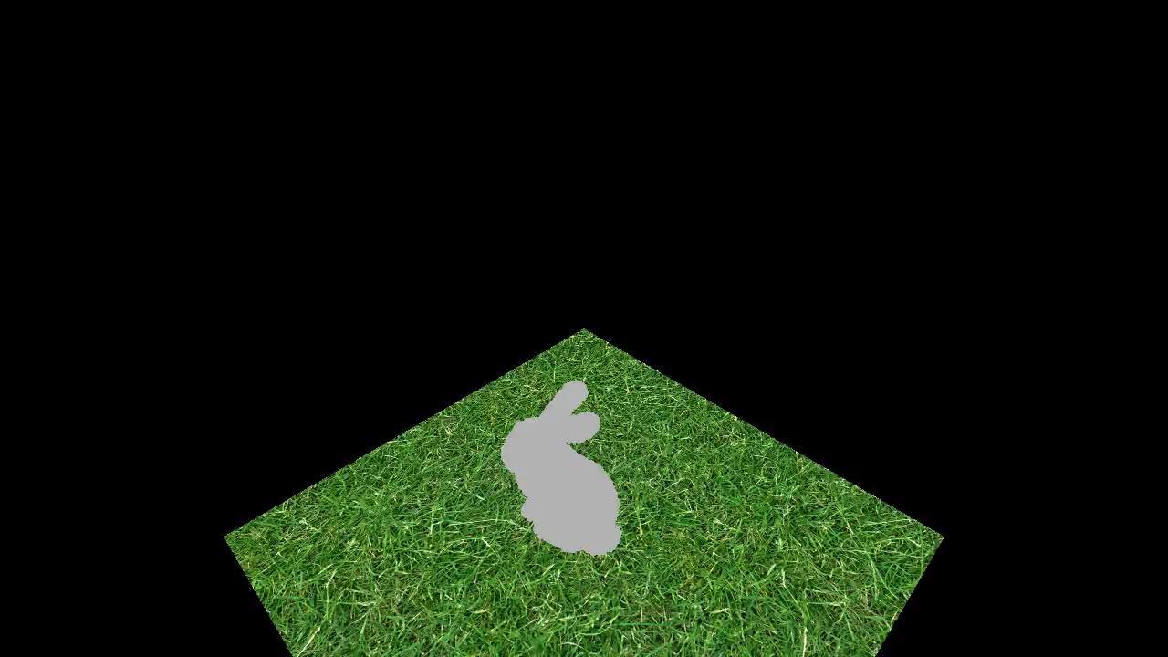
Results

Slide 14
Thanks

